Slide 1
10 Steps To Water Safety at Home

Slide 2
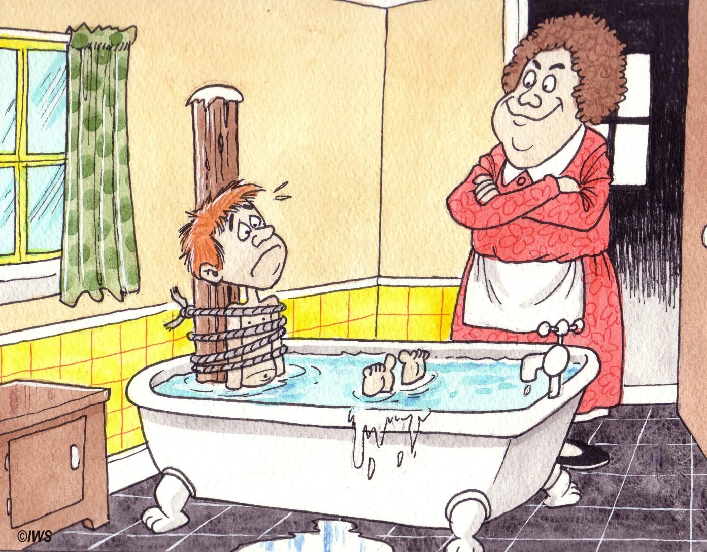
1
Make sure that you are always
supervised at bath time.

Slide 3
2
Empty baths after use. When full, see that no chairs are nearby in case of younger children climbing into the bath.

Slide 4
3
Keep bath plugs out of reach of smaller children.

Slide 5
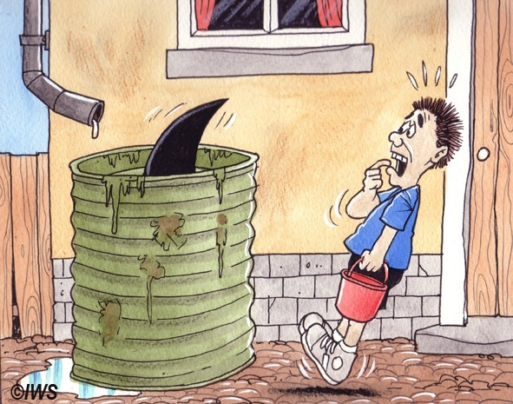
4
Keep away from washing machines and other large containers of water.

Slide 6
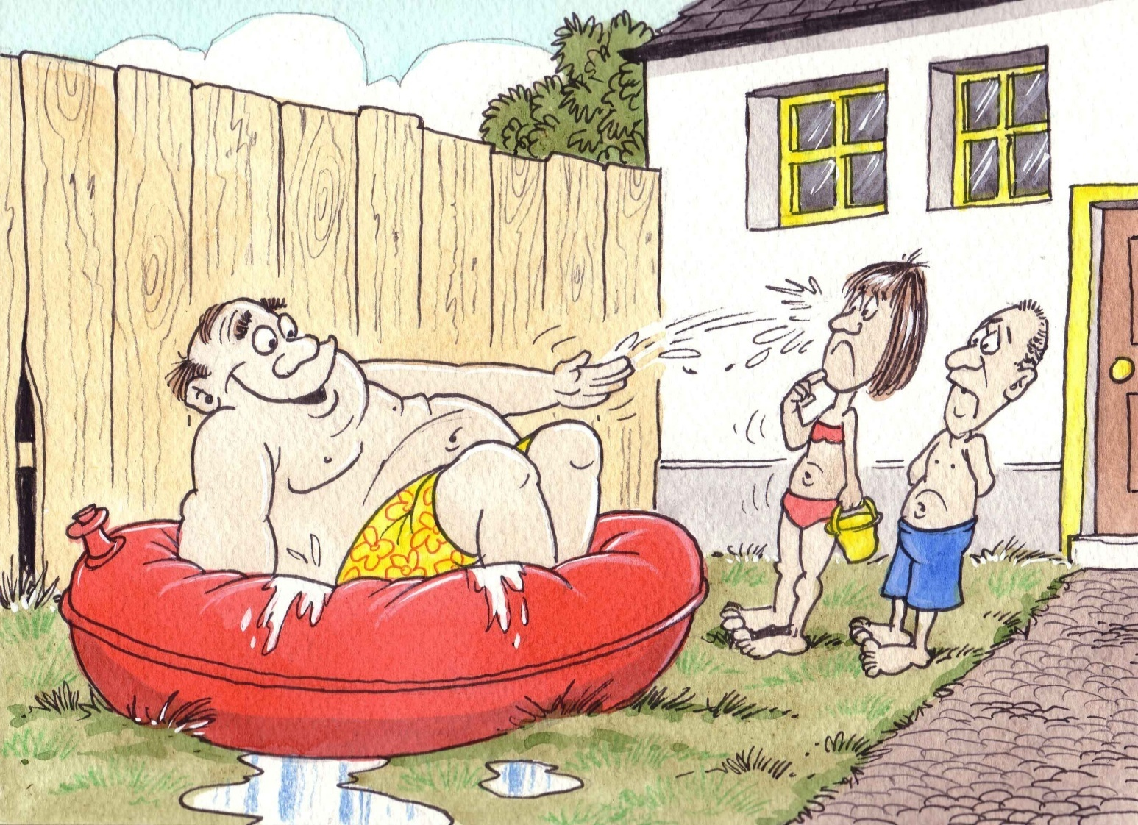
5
An adult should always supervise playtime in paddling pools.

Slide 7
6
Paddling pools should be emptied straight away after use.

Slide 8
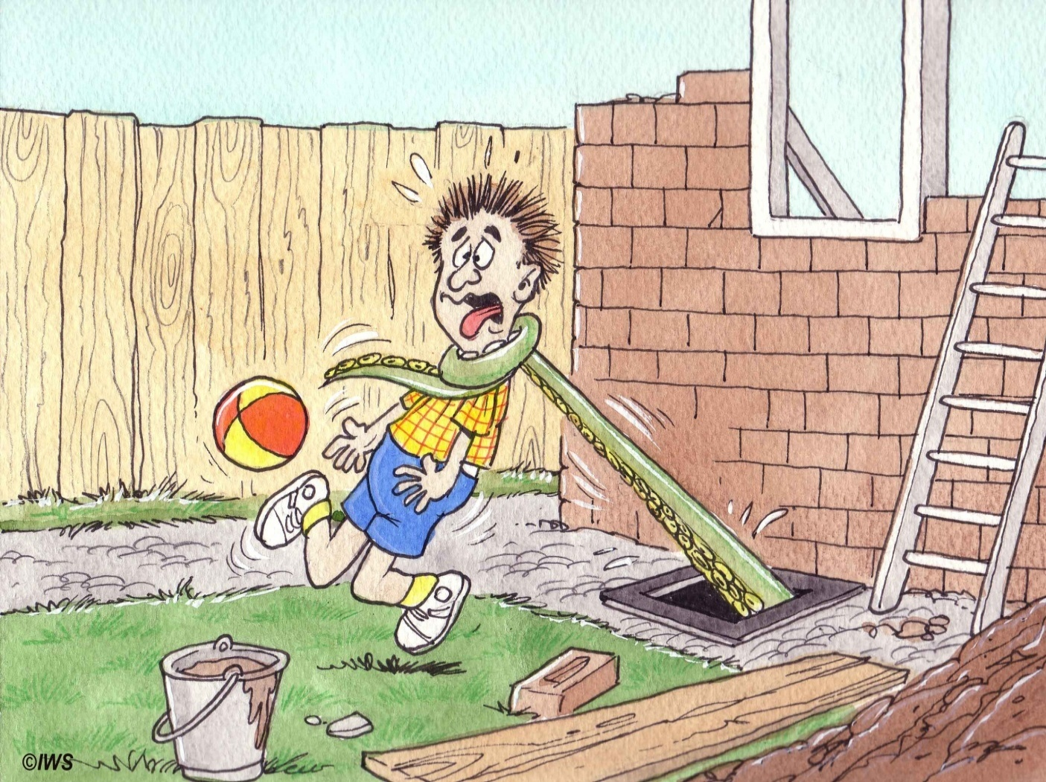
7
Holes or drains left exposed after building work should be covered with mesh.

Slide 9
8
Rain barrels, water tanks, wells and fish ponds should be covered with wire mesh.

Slide 10
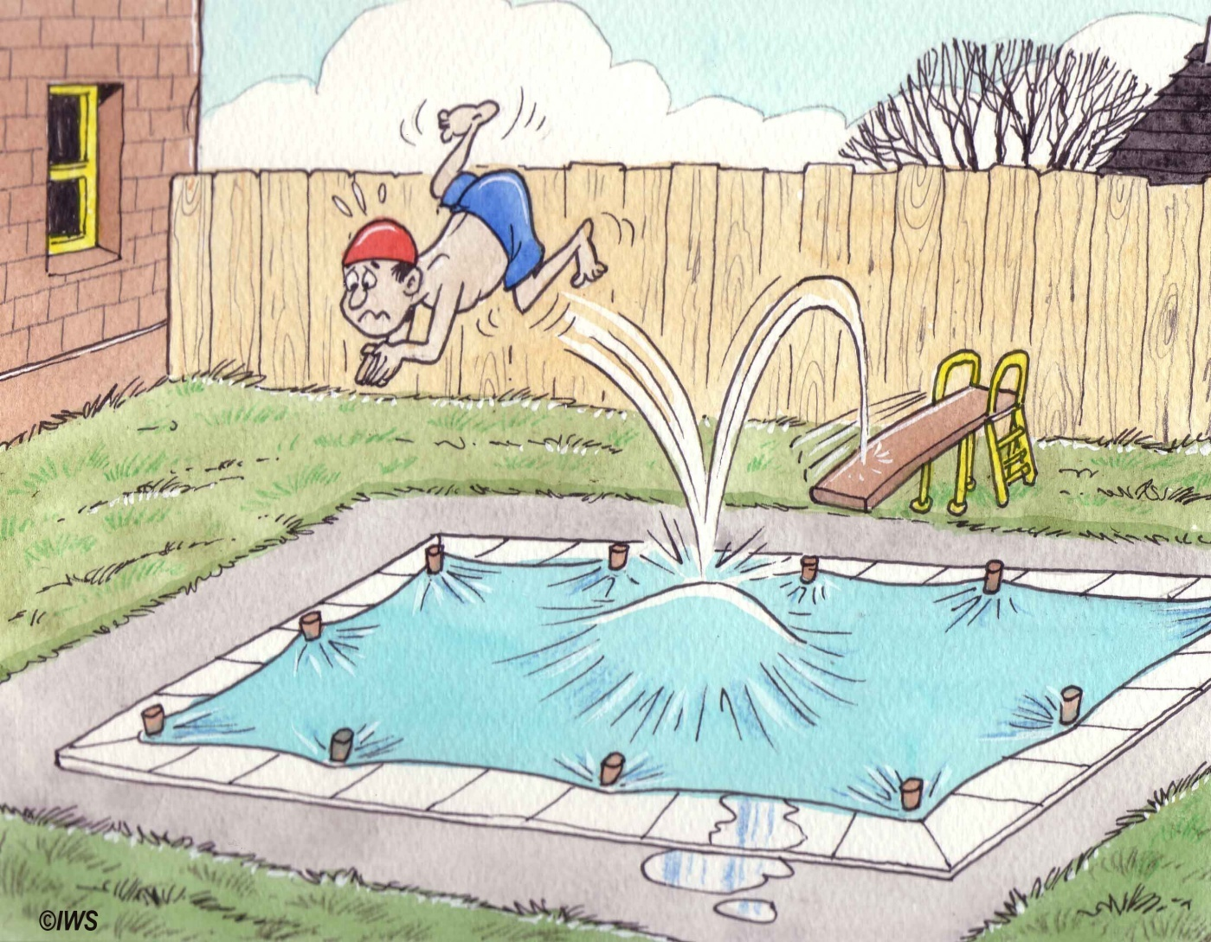
9
Private swimming pools should be fenced off and have covers that can be firmly secured.

Slide 11
10
Adults should fence off any rivers , streams or drains running near the home.

