Slide 1
10 Steps To Water Safety on the Farm

Slide 2
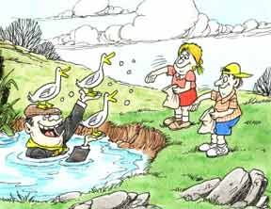
1
Farm ponds are often out of view of the house, so always have an adult with you when you are feeding the ducks or playing

Slide 3
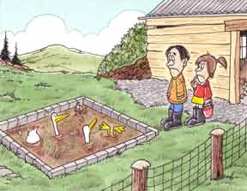
2
Farm slurry pits are not solid enough to stand on. You would sink quickly!

Slide 4
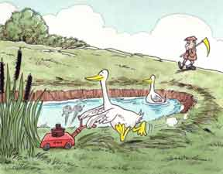
3
Reeds and grass can often hide the edge of the pond.

Slide 5
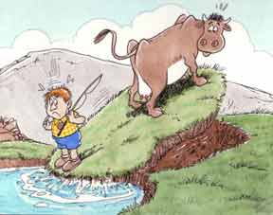
4
The banks of a pond may be weak and give way under your weight.

Slide 6
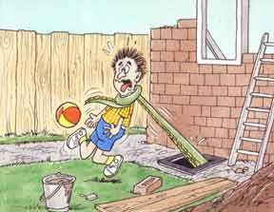
5
Holes or drains left exposed after building work should be closed.

Slide 7
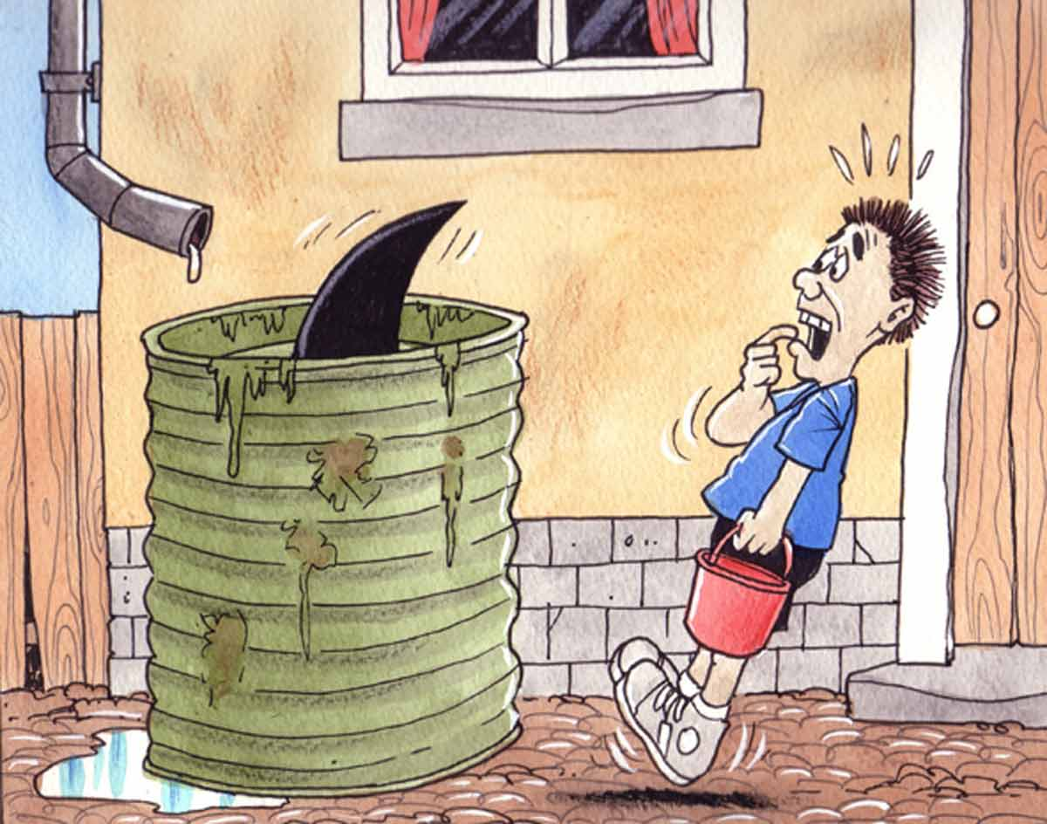
6
Keep away from uncovered water barrels.

Slide 8
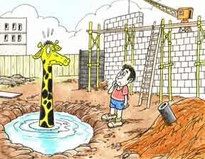
7
You cannot tell how deep a hole is if it is filled with water.

Slide 9
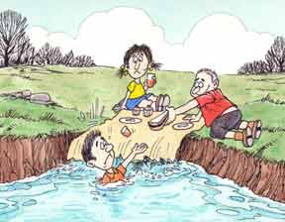
8
Do not play near the edge of riverbanks – it can crumble away suddenly.

Slide 10
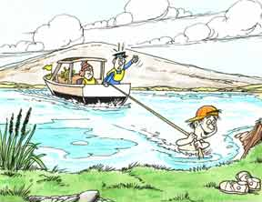
9
Do not retrieve model boats by wading in.

Slide 11
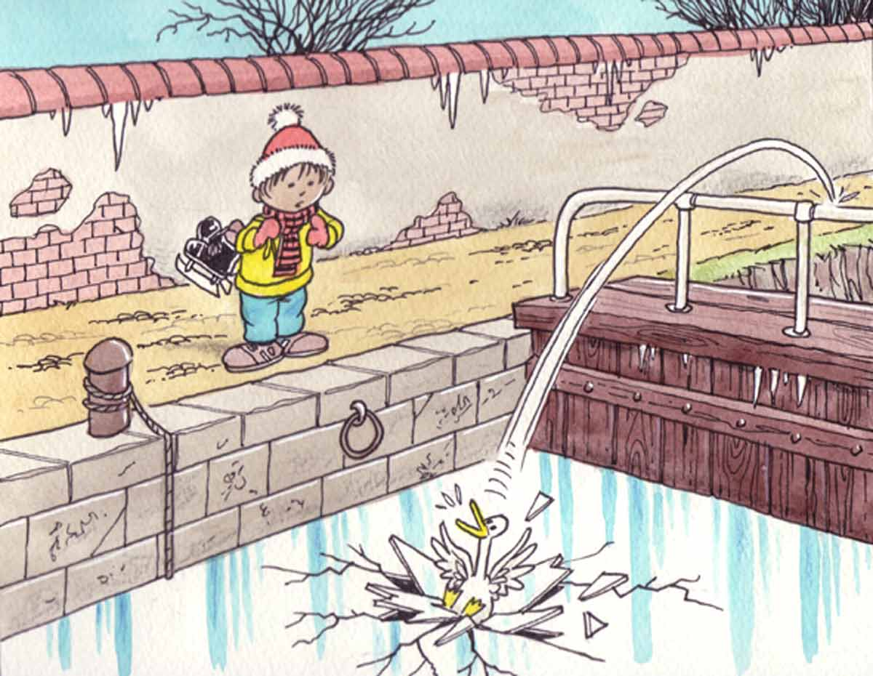
10
Never walk on ice covered waterways.

