Slide 1
14 Steps To Safe & Enjoyable Boating

Slide 2
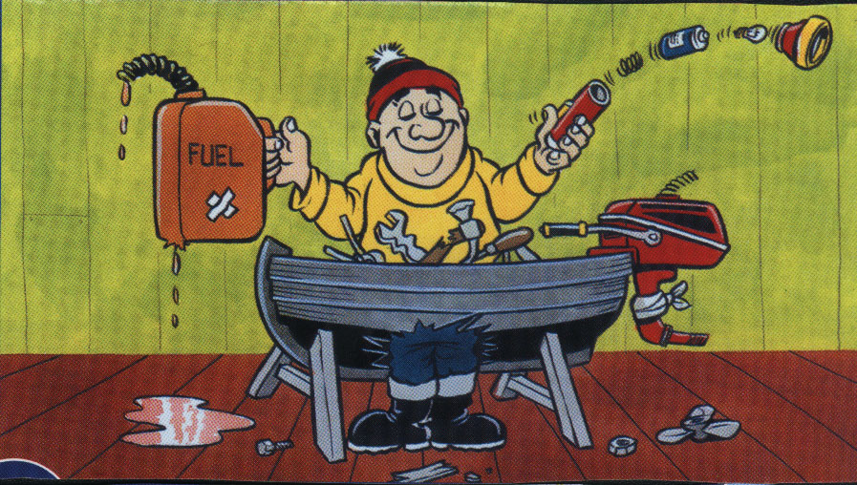
1
Check the condition of the boat, equipment, hull, engine, fuel, tools, torch, etc.

Slide 3
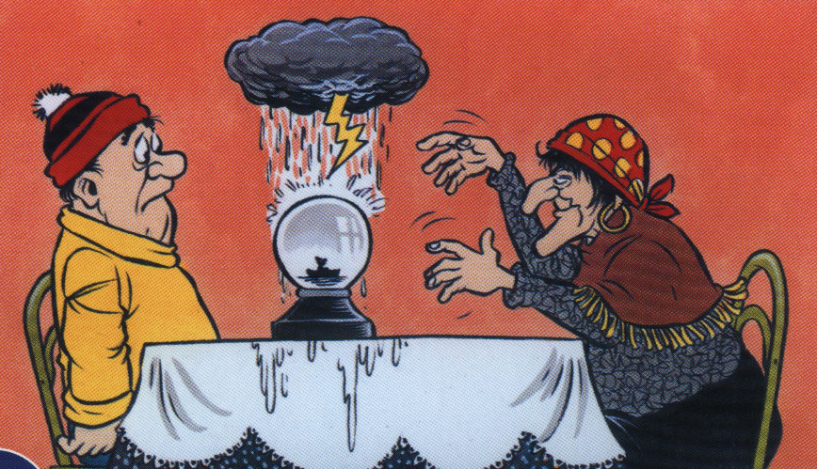
2
Check the weather forecast for the area.

Slide 4
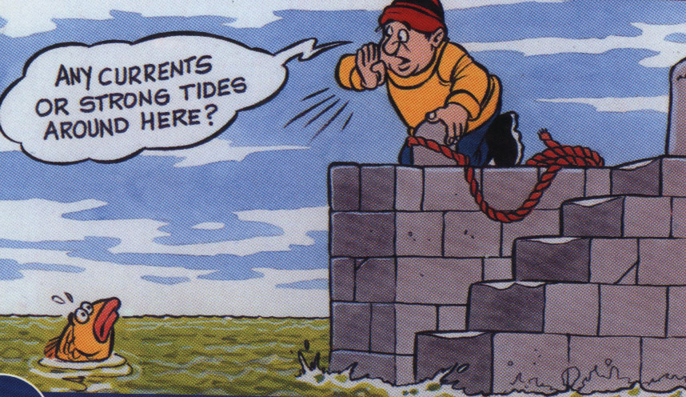
3
Check locally concerning dangerous currents, strong tides, etc.

Slide 5
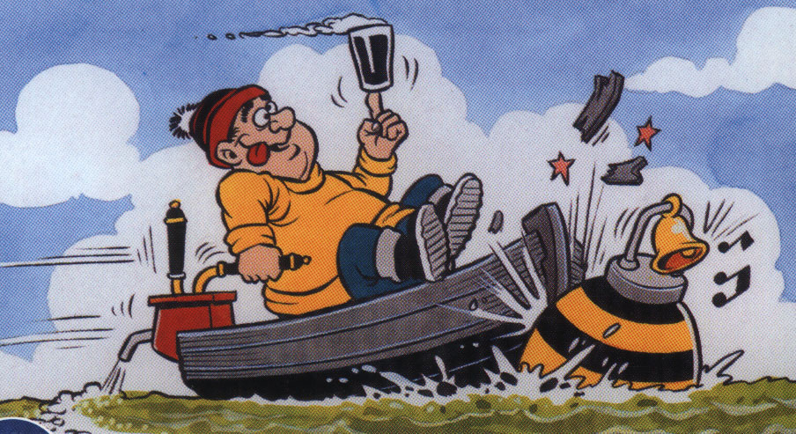
4
Do not drink alcohol when setting out or during your trip.

Slide 6
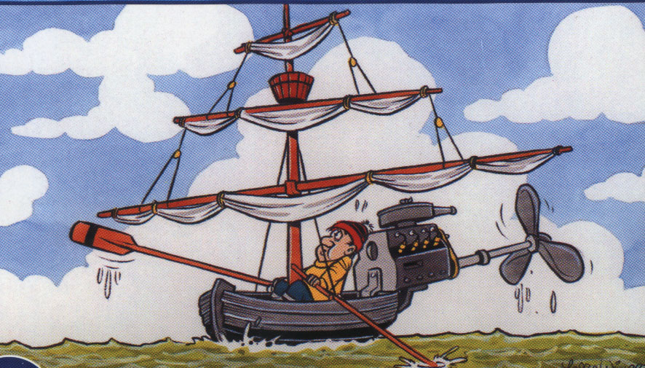
5
Carry an alternative means of propulsion (e.g. sails and oars or motor and oars)

Slide 7
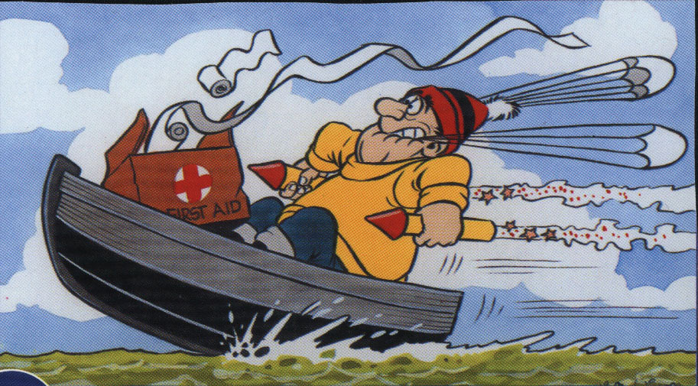
6
Carry a First Aid Kit on board and distress signals

Slide 8
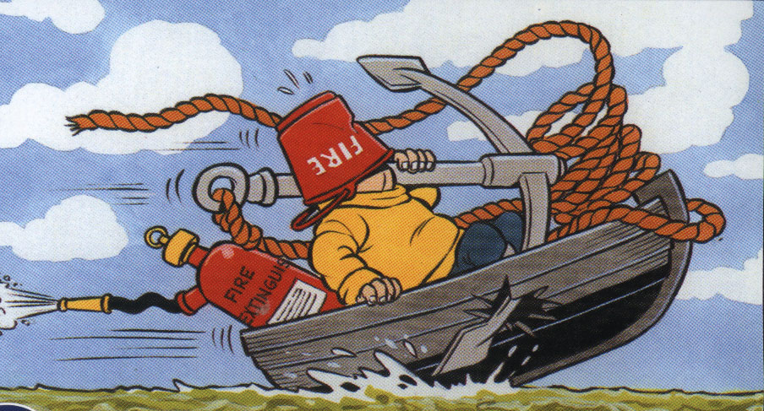
7
Carry a fire extinguisher, a hand bailer or bucket with lanyard and an anchor with rope attached.

Slide 9
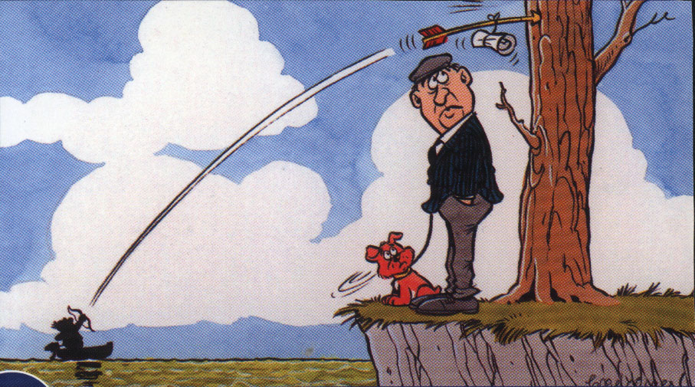
8
Carry a marine radio or some means of communication with shore.

Slide 10
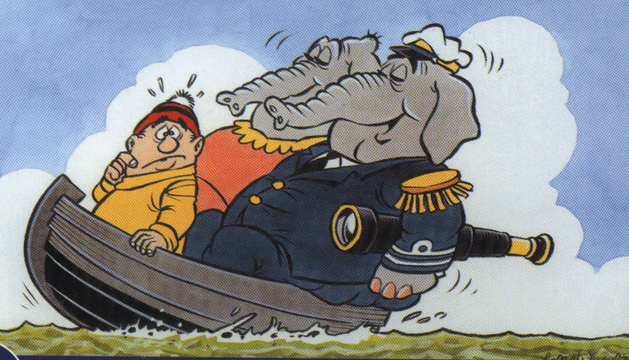
9
Do not overload the boat! This will make it unstable!

Slide 11
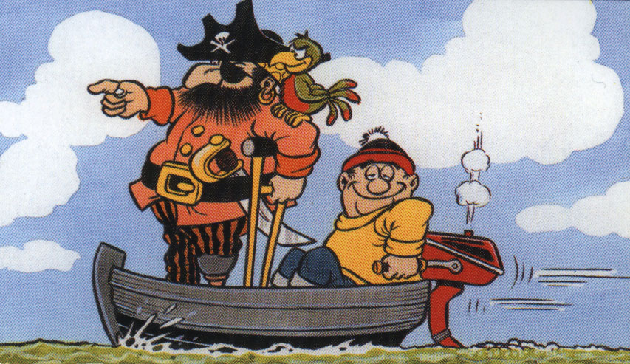
10
Do not set out unless accompanied by an experienced person.

Slide 12
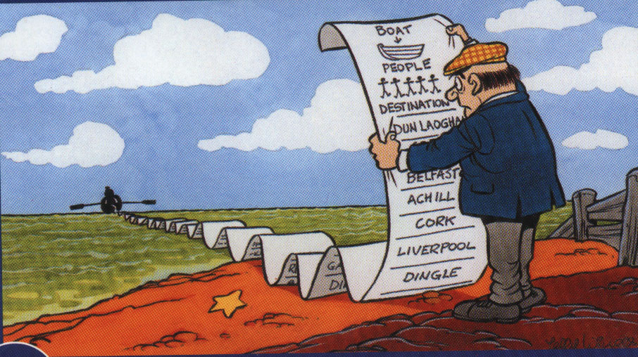
11
Leave details of your planned trip with someone ashore.

Slide 13
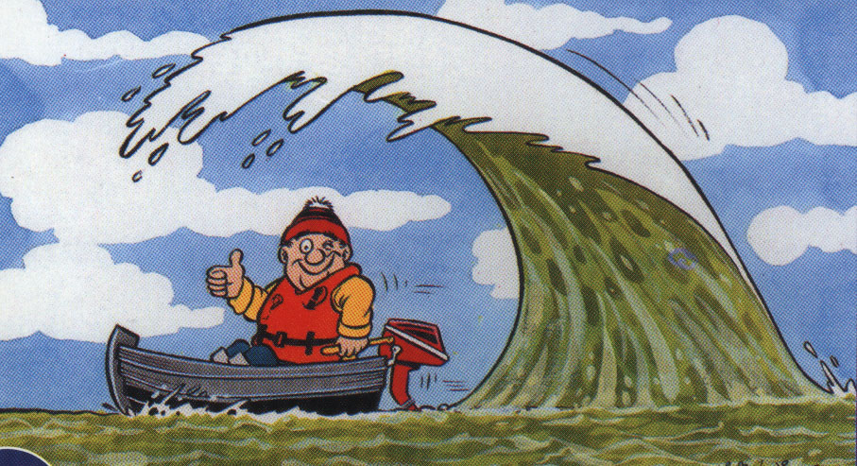
12
Wear a Lifejacket or a Personal Flotation Device (PFD) at all times.

Slide 14
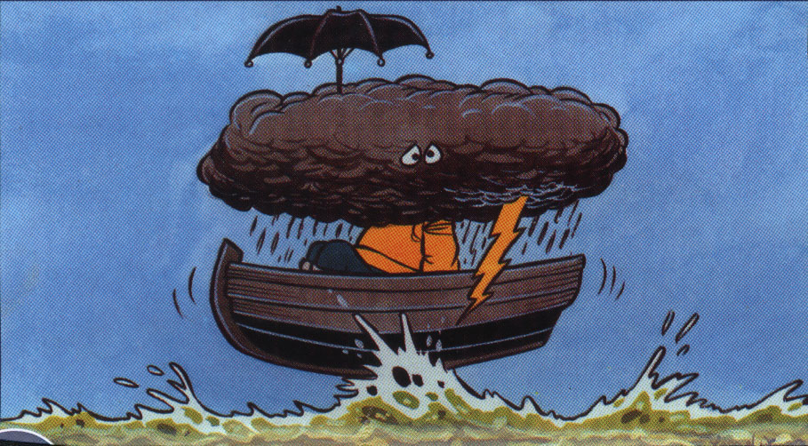
13
Keep an eye on the weather. Seek shelter in good time.

Slide 15
14
REMEMBER THESE RULES… ENJOY YOURSELF… COME HOME SAFELY!

